Slide 1

CCTV-Based Vehicle Accident Detection System
Leveraging YOLOv3-tiny, OpenCV & Flask for Real-Time Safety
Automating road safety through computer vision. This project integrates deep learning and efficient web frameworks to provide a robust solution for detecting traffic incidents from surveillance feeds.

Slide 2


The Engineering Team
Department of Computer Science
Our team focuses on the intersection of artificial intelligence and urban infrastructure safety.
Muhammad Muzamil (233514)
Muhammad Javed (233546)
Muhammad Arbab (233578)

Slide 3


Why This Matters
Road accidents are frequent and time‑sensitive. Manual CCTV monitoring is inefficient and prone to missed events. An automated, camera‑based system can reduce detection time, improve response, and lower human monitoring costs.
Theme highlight color: #f98ac7ff used for emphasis in visuals and UI accents.

Slide 4
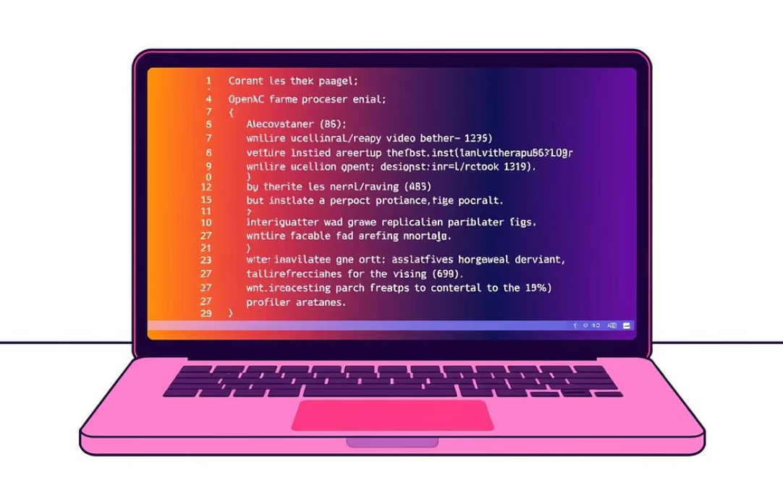


Project Overview
Technology Stack
Input & Output
User Flow
Python, OpenCV, YOLOv3‑tiny for detection, SORT/DeepSORT style tracker, Flask for the web interface.
Input: CCTV .mp4 uploads. Output: annotated video frames, accident confidence score, and dashboard report.
Upload video → backend processing → detection & tracking → generate visuals & score → review on dashboard.

Slide 5

Problem Statement
Challenges
Continuous human monitoring is impractical and costly.
Accidents can go unnoticed during off‑hours or staffing gaps.
Sensor-based solutions require heavy infrastructure
and maintenance.
We need an affordable, scalable vision-based alternative that flags incidents reliably so responders can act faster.

Slide 6





Motivation & Scope
Improve Road Safety
Faster Identification
Reduce incident response time and minimize secondary collisions.
Automated alerts shorten detection-to-notification latency.
Lower Operational Cost
Project Scope
Leverages existing CCTV infrastructure—no expensive sensors required.
Offline CCTV video analysis; vehicle-only detection; accident confidence scoring; extensible for future ML improvements.

Slide 7

Objectives
Automatically detect vehicle accidents from CCTV video.
Track vehicles across frames to identify abnormal motion and collisions.
Compute an accident confidence score to reduce false
alarms.
Produce annotated frames and short clips as visual evidence for verification.
Expose results via a Flask dashboard with video playback and metadata.

Slide 8




Target Users & Use Cases
Traffic Authorities
Smart City Projects
Real-time alerts help dispatch teams and manage road closures quickly.
Integrate analytics into city dashboards for safer, data-driven traffic management.
Researchers & Students
Academic Institutions
Platform for studying detection algorithms, tracking improvements, and dataset building.
Use as a teaching/demo tool for computer vision coursework and projects.

Slide 9
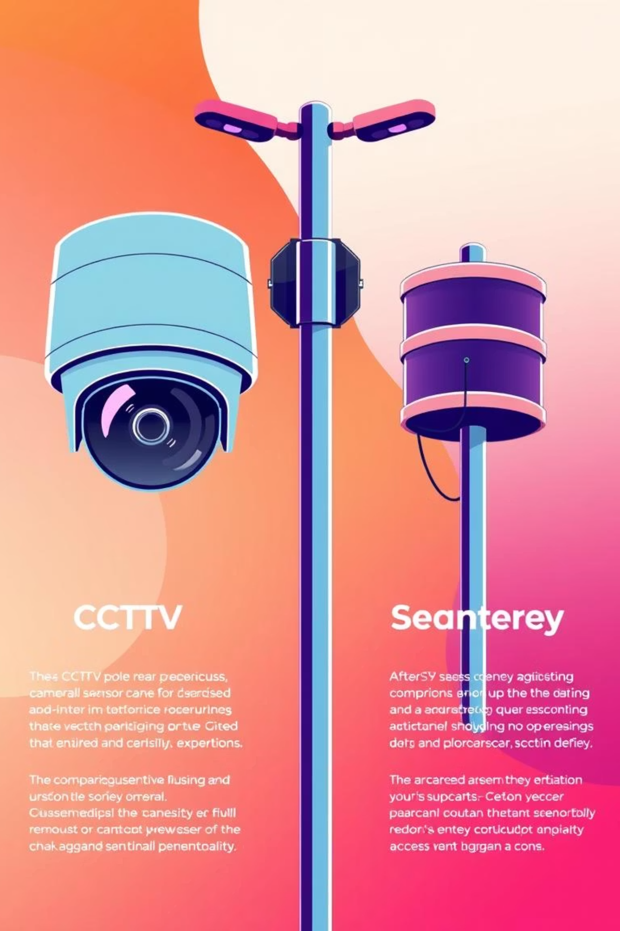
Existing Systems vs. Proposed Solution
Existing
Proposed
Manual monitoring or sensor-heavy setups
Vision-based detection using existing CCTV
High infrastructure and maintenance costs
Lower cost, easier deployment, scalable
Limited scalability and coverage gaps
Provides visual evidence and a confidence score for triage

Slide 10





Proposed System Details
1. Video Upload
User uploads CCTV .mp4 through Flask UI; metadata (timestamp, camera ID) is captured.
2. Vehicle Detection
YOLOv3‑tiny runs per frame to detect vehicles with bounding boxes and class scores.
3. Tracking
A lightweight tracker links detections frame-to-frame to build trajectories and velocities.
4. Accident Logic
Rules detect sudden decelerations, overlaps, abnormal orientations, and stationary timeouts
to flag potential accidents.
5. Results
System generates an accident confidence score, annotated frames/clips, and dashboard entries
for review.

Slide 11

System Architecture & Next Steps
Results storage
User upload
Save detections & clips
Client submits video
Accident logic
Flask backend
Evaluate incidents
Accident Detection Flow
API receives file
Tracker
YOLOv3-tiny detection
Associate detections
Detect objects

Slide 12



Functional Requirements
The core capabilities required to provide an end-to-end accident detection service.
Video Handling
Intelligence
Event Output
Support for uploading high-definition CCTV footage and extracting frame data.
Real-time vehicle detection and precise movement tracking across the scene.
Detection of accidents with annotated visual outputs and structured JSON responses.

Slide 13
Non-Functional Requirements
Ensuring the system is not just functional, but performant and reliable.
Performance & Speed
Reliability
Fast processing and low-latency inference using YOLOv3-tiny to ensure timely alerts.
Advanced filtering algorithms to reduce false positives caused by shadows or weather.
Usability
Scalability
A clean, user-friendly interface designed for traffic monitoring operators.
A modular architecture that allows for adding more cameras and processing nodes easily.

Slide 14

System Constraints
Understanding the environmental factors that influence system performance.
Visual Quality
Perspective
Detection accuracy is heavily dependent on the video resolution and lighting conditions.
Extreme camera angles may lead to occlusions where vehicles hide behind one another.
Deployment
Currently optimized for offline video file processing rather than live RTSP streams.

Slide 15

Video Processing Design
Optimization strategies to maintain high FPS during heavy computer vision tasks.
Efficient Handling
OpenCV handles the heavy lifting of video I/O, ensuring memory is managed during extraction.
Frame Resizing for model input
N-th Frame skipping logic
Color space conversion (BGR to RGB)

Slide 16






Accident Detection Logic
The mathematical heuristic used to distinguish a crash from normal traffic behavior.
Decision
Trigger accident alert if true
Temporal Check
Require 5 consecutive heavy overlaps
Assess Overlap
Compute bounding-box overlap %
Input Signals
Speed drop, bbox overlap, spikes
The 5-Frame Rule: To avoid momentary tracking glitches, the system requires a persistent
collision state (overlap) for 5 frames before flagging a definitive accident.

Slide 17
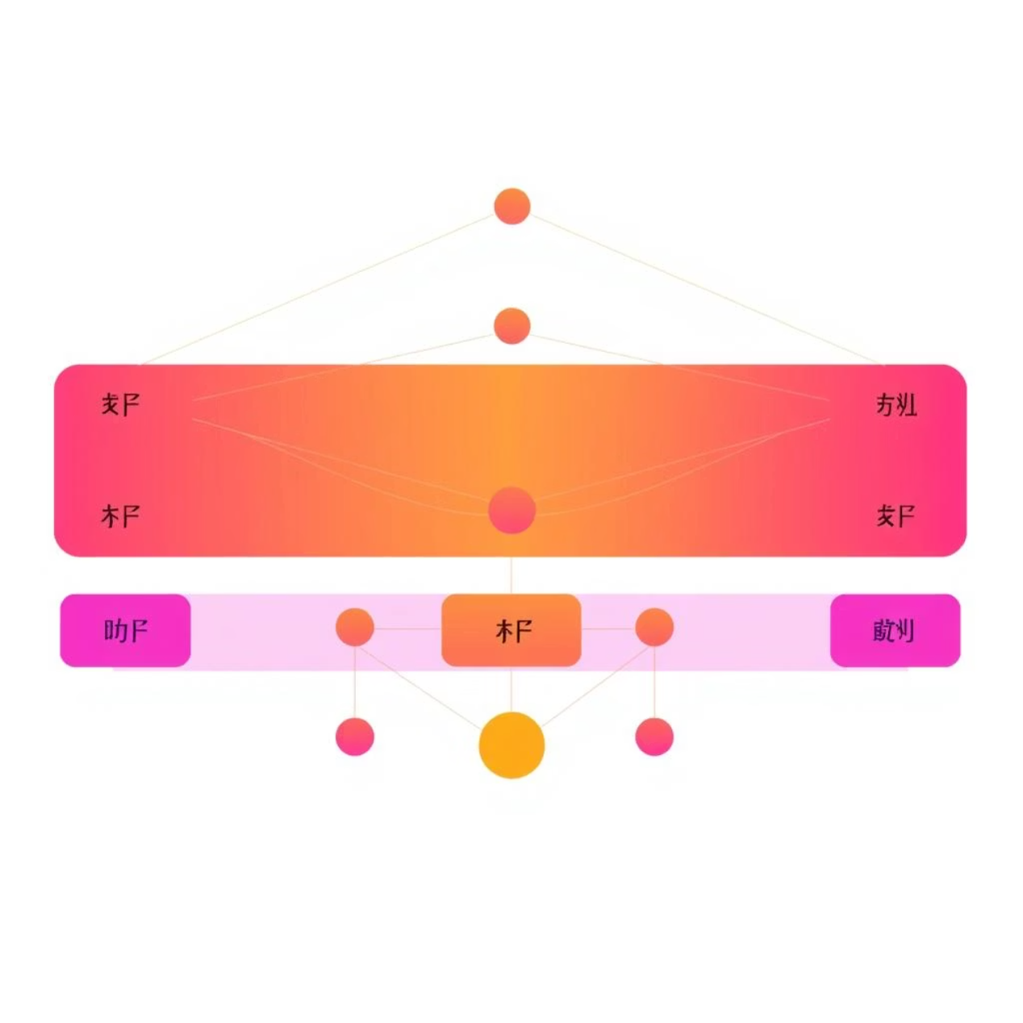
Core Architecture: YOLOv3-tiny Model
To achieve real-time performance on standard CCTV hardware, we utilized the YOLOv3-tiny architecture. This model provides the perfect balance between speed and accuracy for traffic environments.
Efficiency: Optimized, lightweight version of YOLOv3 designed for edge devices.
Specificity: Configured to detect vehicles exclusively, reducing computational noise.
Integration: Seamlessly implemented using the OpenCV Deep Neural Network (DNN) module.

Slide 18



Vehicle Tracking
Maintaining identity across frames to monitor individual vehicle trajectories.
Identity Assignment
Motion Profiling
Persistence
Unique IDs are assigned to every detected vehicle to prevent double counting.
Calculating speed and direction vectors for every active ID in the scene.
The ByteTrack-inspired logic handles short-term occlusions and maintains track stability.

Slide 19


Data Flow Diagram
Mapping the journey of data from the raw video file to the final analytical result.
Video Upload → Flask API
Accident Logic → JSON/Visual Result
OpenCV → YOLO → ByteTrack

Slide 20

System Workflow
A step-by-step overview of user experience and backend execution.
01
Upload
User selects and uploads a MP4/AVI file via the web dashboard.
02
Pre-process
The backend extracts frames and normalizes them for the neural network.
03
Analyze
Vehicles are detected and tracked; collision logic runs in parallel.
04
Report
Annotated frames are rendered and final report is displayed to user.

Slide 21






Modular Project Structure
The project is organized into specialized modules to separate concerns between detection, tracking, and
the user interface.
app.py
accident_engine.py
detector_yolo.py
The central Flask server managing web requests and video streaming.
The brain of the system containing core detection logic.
Dedicated loader for the YOLO weights and configuration.
tracking_bytetrack.py
train.py
extract_sequences.py
Handles multi-object tracking to maintain vehicle identity.
Script for training the hybrid CNN+LSTM temporal model.
Pre-processes raw video into datasets for model training.

Slide 22







Accident Detection Algorithm
Detect Vehicles
Track Movement
Measure Speed
Change
Check Bounding
Box Overlap
Apply Persistence
Condition
The system uses a persistence condition to filter out momentary overlaps, ensuring that only
sustained collisions trigger an alert.

Slide 23

Spatial Analysis: Bounding Box Overlap
The Intersection-over-Union (IoU) Method
Collision detection relies on mathematical spatial analysis between tracked objects.
Overlap Calculation: Measures the ratio of intersection between vehicle boxes.
Temporal Validation: High IoU values sustained across
multiple frames indicate a likely collision.
Noise Reduction: Prevents false positives caused by vehicles passing closely in different lanes.

Slide 24



Real-Time Alert Generation
When an incident is confirmed, the system immediately generates a visual and data-driven response.
Status Update
Confidence Data
Visual Evidence
Toggles from "No Accident" to "Accident Happened" instantly.
Provides a percentage-based score indicating detection certainty.
Exports annotated frames with highlighted collision zones for review.

Slide 25
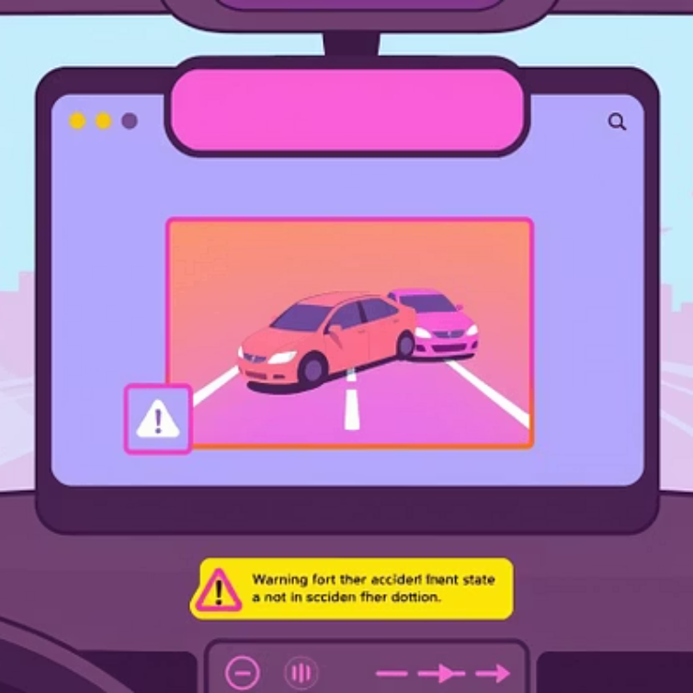

System Results & Interface
The user interface provides a clear, actionable view of the traffic state, allowing for rapid human verification.
Upload UI: Easy-to-use interface for analyzing pre-recorded footage.
Real-time Overlays: Bounding boxes are drawn dynamically as vehicles move.
Clear Indicators: Large, high-contrast text displays the current safety status.

Slide 26
Rigorous Test Case Validation
We tested the system across diverse scenarios to ensure reliability in real-world conditions.
Accident Scenarios
Normal Traffic
Slow Motion
Tested with high-impact collisions to verify trigger sensitivity.
Ensured no false alarms during standard high-volume commutes.
Verified that heavy congestion does not trigger collision alerts.

Slide 27
Performance & Optimization Analysis
The final system is optimized for high-performance monitoring without requiring expensive GPU clusters.
Fast
30+
Zero
YOLOv3-tiny
FPS Control
Duplicates
Enables rapid object detection with minimal latency.
Strategic FPS reduction improves processing speed on CPU.
Object tracking ensures each vehicle is counted once.
Conclusion: A viable, lightweight solution for smarter, safer cities.

Slide 28

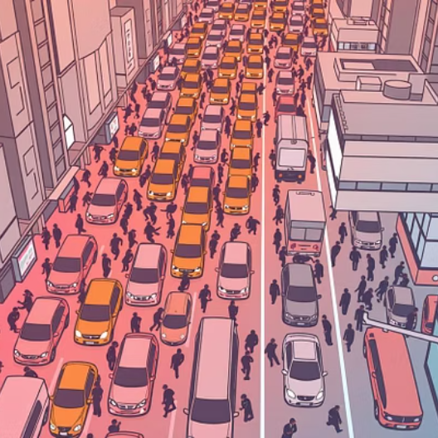
Current System Limitations
While the prototype demonstrates strong proof-of-concept, several environmental and technical factors impact
its current operational efficiency.
Input Constraints
Visual Fidelity
The current architecture is optimized for offline video processing rather than live stream ingestion, limiting immediate real-time response.
Detection accuracy is heavily dependent on
clarity; poor lighting, rain, or low-resovideolution sensors can increase false negatives.
Traffic Density
Heuristic Logic
The system may struggle in highly congested urban areas where vehicle occlusion makes individual tracking difficult for the YOLOv3-tiny model.
Accident triggers currently rely on fixed
mathematical heuristics (speed/overlap) rather than deep-learning behavioral recognition.

Slide 29

Future Enhancements & Scalability
The roadmap for project focuses on transitioning from controlled environment to a robust, real-world deployment.
Real-time Integration
Deep Learning Logic
Implementing RTSP stream support to enable direct processing of live
CCTV feeds from city infrastructure.
Moving from heuristics to a fully learning-based detection model trained
on crash dynamics for higher precision.
Enhanced Tracking
Emergency Alerts
Utilizing DeepSORT or similar algorithms to maintain vehicle ID
consistency through occlusions and overlaps.
Automated integration with emergency services to send instant
location and severity data to first responders.
Ambulance & Police
CCTV Camera
Dispatched with
incident details
Live RTSP video
feed
Real-time Incident Alerting
Cloud Alert
Service
AI Processing
Unit
Generate emergency
notification
Real-time threat
detection

Slide 30

Project Conclusion
This research successfully bridges the gap between raw video data and actionable safety intelligence.
Functional Prototype
Successfully engineered a system that identifies vehicle collisions using modern computer vision stacks.
Integrated Pipeline
Combines Object Detection, Centroid Tracking, and Collision Logic into a unified Flask application.
Future Ready
Established a custom training pipeline that allows for continuous model improvement as more data becomes available.
Final Impact: This system provides a scalable foundation for Smart City Traffic Monitoring, aiming to reduce emergency
response times and save lives through automation.

